Slide 1
Chapter 7: Geospatial, Temporal & Streaming Data Analysis
Following: [3] "Advanced Analytics with Spark", Chapter 8
Prof. Dr. Martin Theobald
Faculty of Science, Technology & Communication
University of Luxembourg

Slide 2
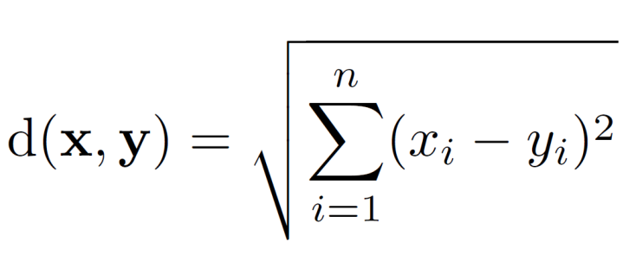
What is Temporal & Spatial Data?
Spatial data is a form of multidimensional data in which some – typically a few – attributes denote annotations over a continuous (spatial) domain. Most common such annotations are:
Temporal: 1d annotations (time points where a series of consecutive measurements from the same source are then called a "session" or a "time-series")
Geographic: mostly 2d (latitude/longitude pairs as in the GIS and GeoJSON standards), perhaps 3d annotations (plus elevation as in the GPS standard)
The most common mathematical representation for multidimensional data points is the Euclidian space with Euclidian distance as distance metric:

Slide 3
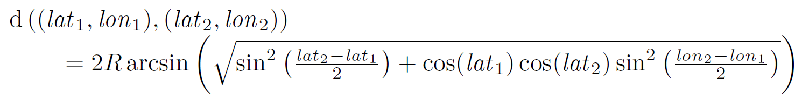
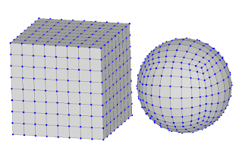

Spheres & Polygons
However, Euclidian distance does not work well for the actual surface distance of two points on a spherical shape (e.g., the shortest path between north and south pole would go through the center of the earth).
Thus, for the surface distance of two pairs of longitude/latitude points, the Haversine formula is more appropriate (it considers curvature of the planet):
(→ use $R = 6,371$ km for this planet!)
Finally, polygons can approximate arbitrary 2d and 3d surfaces (which may then additionally also be projected onto a sphere) by a discrete set of polygon boundaries (rectangles, triangles or quadrilaterals).
Convex polygon: all internal angles among adjacent edges are $≤$ 180$°$.
Concave polygon: at least one internal angle among a pair of adjacent edges is > 180$°$.

Slide 4
GeoJSON Example & Online Demo
http://geojson.io/#map=12/40.6097/-74.0657

Slide 5
The NYC-Taxi-Trips & NYC-Boroughs Data Sets
The NYC Taxi Trips data set is a collection of taxi trips and fares in downtown New York City from January 2013 in CSV format:
http://www.andresmh.com/nyctaxitrips/
The uncompressed file contains 2.5 GB of data for 14.8 million individual taxi rides. Each line contains a driver's license id, start- and end-time, a pick-up GPS location and a drop-off GPS location.
The second data set contains polygons of NYC city areas ("boroughs") such as Manhattan, Brooklyn, Queens, etc. in GeoJSON format:
https://github.com/haghard/streams-recipes/blob/master/
master/nyc-borough-boundaries-polygon.geojson
A basic geospatial & temporal analytical query pattern (which we will try to solve in the following slides) may look as follows:
How long does it take on average for a taxi driver to find a new customer with respect to the borough and the hour-of-day?
See here for a very cool visualization of the NYC taxi trips!

Slide 6
Date & Time APIs
The Java "built-in" DateTime and SimpleDateFormat libraries are used for parsing date/time strings:
import java.text.SimpleDateFormat
val format = new SimpleDateFormat("yyyy-MM-dd HH:mm:ss")
val date = format.parse("2014-10-12 10:30:44")
val datetime = new DateTime(date)
The joda and nscala libraries are used to capture durations:
import com.github.nscala_time.time.Imports._
val dt1 = new DateTime(2014, 9, 4, 9, 0)
val dt2 = new DateTime(2014, 10, 31, 15, 0)
val d = new Duration(dt1, dt2)
d.getMillis
d.getStandardHours
d.getStandardDays

Slide 7
Geometric APIs
The esri library provides a special Geometry object as a basic data structure for 2d geospatial objects that are encoded as polygons of longitude/latitude pairs.
import com.esri.core.geometry.Geometry
import com.esri.core.geometry.GeometryEngine
import com.esri.core.geometry.SpatialReference

Slide 8
Extended Geometry API (I)
To spare syntax in our further programs, we define a new helper class, called RichGeometry, which serves as a wrapper for the Geometry class.
The standard we will use for spherical distance computations among a pair of GPS coordinates is WKID 4326.
class RichGeometry(val geometry: Geometry,
val spatialReference: SpatialReference =
SpatialReference.create(4326)) {
def area2D() = geometry.calculateArea2D()
def contains(other: Geometry): Boolean = {
GeometryEngine.contains(geometry, other, spatialReference) }
def distance(other: Geometry): Double = {
GeometryEngine.distance(geometry, other, spatialReference) }
}

Slide 9
Extended Geometry API (II)
Next, we declare a companion object for RichGeometry that provides support for implicitly converting instances of the Geometry class into the RichGeometry class (add additional functionality to existing Geometry class):
object RichGeometry {
implicit def wrapRichGeo(g: Geometry) = {
new RichGeometry(g) } }
And make sure to import the implicit function definition into the Scala environment:
import RichGeometry._

Slide 10
GeoJSON API
The spray package provides a commonly used API for the GeoJSON standard:
import spray.json.JsValue
case class Feature(
val id: Option[JsValue],
val properties: Map[String, JsValue],
val geometry: RichGeometry) {
def apply(property: String) = properties(property)
def get(property: String) = properties.get(property) }
Polygons are encoded in GeoJson as so-called feature collections:
case class FeatureCollection(features: Array[Feature])
extends IndexedSeq[Feature] {
def apply(index: Int) = features(index)
def length = features.length }

Slide 11
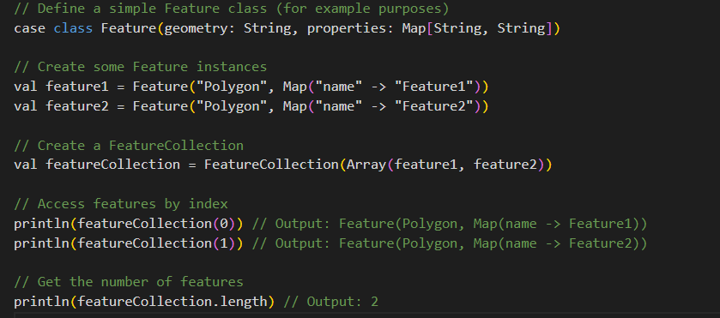
GeoJSON API (example)
Polygons are encoded in GeoJson as so-called feature collections:
case class FeatureCollection(features: Array[Feature])
extends IndexedSeq[Feature] {
def apply(index: Int) = features(index)
def length = features.length }

Slide 12
Reading and Writing a Collection of GeoJSON Objects
implicit object FeatureJsonFormat extends
RootJsonFormat[Feature] {
def write(f: Feature) = {
val buf = scala.collection.mutable.ArrayBuffer(
"type" -> JsString("Feature"),
"properties" -> JsObject(f.properties),
"geometry" -> f.geometry.toJson)
f.id.foreach(v => { buf += "id" -> v})
JsObject(buf.toMap) } }
def read(value: JsValue) = {
val jso = value.asJsObject
val id = jso.fields.get("id")
val properties = jso.fields("properties").asJsObject.fields
val geometry = jso.fields("geometry").convertTo[RichGeometry]
Feature(id, properties, geometry) }

Slide 13
Geospatial Data Structure for the Taxi-Trip Data Set
Based on the esri geometric and nscala date/time packages, we now define a custom data structure for our taxi trips:
import com.esri.core.geometry.Point
import com.github.nscala_time.time.Imports._
case class TaxiTrip(
pickupTime: DateTime,
dropoffTime: DateTime,
pickupLoc: Point,
dropoffLoc: Point)
The parser for the specific date/time format used in the taxi data:
val formatter = new SimpleDateFormat(
"yyyy-MM-dd HH:mm:ss")
And finally a GPS coordinate is parsed from two input strings:
def point(longitude: String, latitude: String): Point = {
new Point(longitude.toDouble, latitude.toDouble) }

Slide 14
Parse the Taxi-Trip Data Set
The parse function extracts all the information we need capture taxi drivers and their trip data from each line of the CSV file:
def parse(line: String): (String, TaxiTrip) = {
val fields = line.split(',')
val license = fields(1)
val pickupTime = new DateTime(formatter.parse(fields(5)))
val dropoffTime = new DateTime(formatter.parse(fields(6)))
val pickupLoc = point(fields(10), fields(11))
val dropoffLoc = point(fields(12), fields(13))
val trip = TaxTrip(pickupTime, dropoffTime, pickupLoc,
dropoffLoc)
(license, trip) }

Slide 15
Interactively Analyze Invalid Records
Either[left, right] provides an interesting mechanism in Scala to split the output of a function into two disjoint sets. These are initialized from the Left and Right constructors.
We can employ this as a wrapper for our actual parse function to debug interactively inspect and possibly debug mistakes in the CSV data.
def safe[S, T](f: S => T): S => Either[T, (S, Exception)] = {
new Function[S, Either[T, (S, Exception)]] with Serializable {
def apply(s: S): Either[T, (S, Exception)] = {
try {
Left(f(s))
} catch {
case e: Exception => Right((s, e))
}
} } }

Slide 16
Wrapper for Safe Parsing
Now we may finally read the taxi data from the CSV file into an RDD (Resilient Distributed Dataset) by using the regular line-by-line input format:
val taxiRaw = sc.textFile("./path-to-taxi-trip-data")
val taxiHead = taxiRaw.take(10)
taxiHead.foreach(println)
This first RDD is transformed into a second RDD using the safe parsing function:
val safeParse = safe(parse)
val taxiParsed = taxiRaw.map(safeParse)
taxiParsed.cache()
And inspect the good vs. the bad (i.e., erroneous) tuples:
taxiParsed.map(_.isLeft).countByValue().foreach(println)

Slide 17
Handling Bad Records
We need two steps to filter the out the bad tuples from the RDD with all parsed tuples:
val taxiBad = taxiParsed.filter(_.isRight).map(_.right.get)
val taxiBad = taxiParsed.collect({
case t if t.isRight => t.right.get
})
And inspect the bad tuples (these are actually not too many):
taxiBad.collect().foreach(println)

Slide 18
Handling Good Records
The good tuples are kept and also cached for further processing:
val taxiGood = taxiParsed.collect({
case t if t.isLeft => t.left.get
})
taxiGood.cache()
The further inspect the good tuples for unusual trip durations:
import org.joda.time.Duration
def getHours(trip: TaxiTrip): Long = {
val d = new Duration(
trip.pickupTime,
trip.dropoffTime)
d.getStandardHours }
taxiGood.values.map(getHours).countByValue().
toList.sorted.foreach(println)

Slide 19
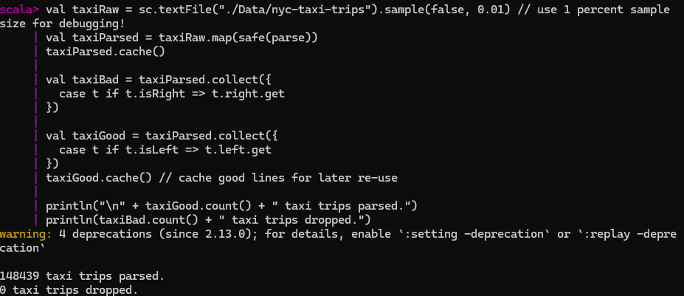
Handling Good Records

Slide 20
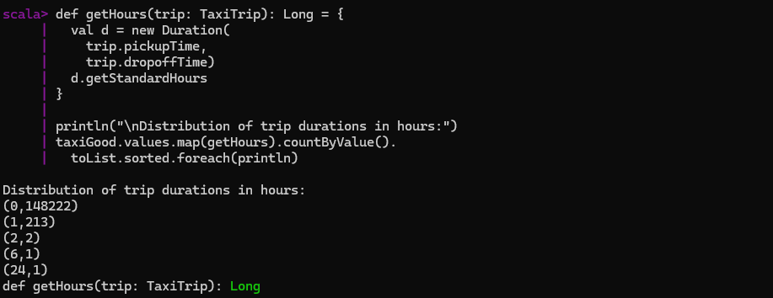
Filtering Out Meaningless Records
Suspicious taxi trips are those that have a negative trip time or that take more than 3 hours (at least for NYC circumstances). The remaining ones are kept in a third RDD:
val taxiClean = taxiGood.filter {
case (lic, trip) => {
val hrs = hours(trip)
0 <= hrs && hrs < 3}}

Slide 21
Geospatial Data Analysis: Load the NYC Boroughs Geometry
GeoJSON objects are first loaded from a file …
val geojson = scala.io.Source.
fromFile("./nyc-borough-boundaries-polygon.geojson").mkString
... and can then very conveniently be parsed directly via the spray API:
import com.cloudera.science.geojson._
import GeoJsonProtocol._
import spray.json._
val features = geojson.parseJson.convertTo[FeatureCollection]
Let's test our new geometry function to look up the borough of a given query point:
val p = new Point(-73.994499, 40.75066)
val borough = features.find(f => f.geometry.contains(p))

Slide 22
Mapping from Borough Codes to Geometry Objects
Next, we will store the polygons captured by the feature collections and map them to their borough names (such as Queens, Brooklyn, etc.).
val areaSortedFeatures = features.sortBy(f => {
val borough = f("boroughCode").convertTo[Int]
(borough, -f.geometry.area2D())
})
Note: “-f.geometry.area2D()” calculates the negative of the area of the polygon represented by the feature. Sorting by negative area puts larger areas first.
The polgyons are broadcast and accessed via a new borough function:
val bFeatures = sc.broadcast(areaSortedFeatures)
Note: use “sc.broadcast” to distribute large datasets to all worker nodes.
def borough(trip: TaxiTrip): Option[String] = {
val feature: Option[Feature] = bFeatures.value.find(f => {
f.geometry.contains(trip.dropoffLoc) })
feature.map(f => {
f("borough").convertTo[String]
})}
Note: map taxi trips to their respective boroughs based on their dropoff locations.

Slide 23
Analyze the Filtered Records
We can now for the first time combine the information from both data sets by analyzing the frequencies of the individual boroughs as the drop-off locations for the tax trips:
taxiClean.values.map(borough).countByValue().foreach(println)
Since there still seem to be many empty ones, we'll do more filtering and check for the most frequent drop-off boroughs:
taxiClean.values.filter(t => borough(t).isEmpty).
take(10).foreach(println)

Slide 24
More Filtering
If the GPS recording of a trip in the taxi data set did not work properly, the coordinates seem to have been set to a default value of (0.0/0.0).
We can filter out these entries as follows:
def hasZero(trip: Trip): Boolean = {
val zero = new Point(0.0, 0.0)
(zero.equals(trip.pickupLoc) || zero.equals(trip.dropoffLoc))
}
This will result in our final RDD which we will cache for further processing:
val taxiDone = taxiClean.filter {
case (lic, trip) => !hasZero(trip)
}.cache()
taxiDone.values.map(borough).countByValue().foreach(println)

Slide 25
"Sessionization" of Taxi Trips
A session of consecutive tax trips is a series of rides offered by the same driver.
We can obtain all of these sessions in a single pass over all taxi trips by:
using the drivers' license ids as primary sorting condition;
using the trips starting times as secondary sorting condition;
splitting sessions that take more than a certain time span.

Slide 26
Sessionization via Secondary Sorting (I)
Recall that the first attribute in the taxiDone RDD is the driver's license. This attribute will also serve as the primary sorting condition for our taxi trips.
A secondary sorting condition can be defined by the pickup times of each driver and taxi trip, which are selected by an additional function:
def secondaryKey(trip: TaxiTrip) = trip.pickupTime.getMillis
An optional split function can be applied to split groups of drivers/consecutive trips with a duration of more than 4 hours (because then a driver is obliged to take a break):
def split(t1: TaxiTrip, t2: TaxiTrip): Boolean = {
val p1 = t1.pickupTime
val p2 = t2.pickupTime
val d = new Duration(p1, p2)
d.getStandardHours >= 4 }
Note: calculate the duration between the pickup times of the two consecutive trips of the same driver and If the duration between the pickup times is greater than or equal to 4 hours, return True, indicating that there should be a split between these two trips.

Slide 27
Sessionization via Secondary Sorting (II)
The final sessions are then obtained by a single groupByKeyAndSortValues call over the taxiDone RDD.
The resulting RDD is also cached. Here, 30 denotes the desired number of partitions in this RDD.
val sessions = groupByKeyAndSortValues(
taxiDone, secondaryKey, split, 30)
sessions.cache()

Slide 28
Analyzing Sessions by the City Boroughs
The next function analyzes all pairs of taxi trips, in which the first trip ended in a particular borough and the second trip ended in any (other) borough.
The function returns the drop-off borough of the first trip together with the duration between the drop-off time of the first trip and the pick-up time of the second trip.
The function will be called for pairs of trips that are done by the same taxi driver/license id:
def boroughDuration(t1: TaxiTrip, t2: TaxiTrip) = {
val b = borough(t1)
val d = new Duration(t1.dropoffTime, t2.pickupTime)
(b, d)
}

Slide 29
The "Sliding" Operator
Using the sliding operator we may obtain an iterator over the sorted trips we defined to entail our sessions.
The filter function ensures that we only analyze sessions that consist of exactly two trips.
The result is of type RDD[(Option[String], Duration)] which we cache.
val boroughDurations: RDD[(Option[String], Duration)] =
sessions.values.flatMap(trips => {
val iter: Iterator[Seq[TaxiTrip]] = trips.sliding(2)
val viter = iter.filter(_.size == 2)
viter.map(p => boroughDuration(p(0), p(1)))
}).cache()
Note:
”sessions – groupByKeyAndSortValues” RDD;
“sessions.values” – trips;
“flatMap” is used to apply a function to each session and flatten the result;
trips.sliding(2) – create a tuple of size 2 of consequtive trips (with stride 1);
“viter.map(p => boroughDuration(p(0), p(1))) “ maps each pair of trips to tuple (borough, durationBetweenTrips).

Slide 30
Analyze the Session Durations
Another inspection of these durations (in hours) reveals that very few remaining trip pairs seem to be invalid (e.g., have a negative session duration). We may decide to either keep or ignore these in our final analysis.
boroughDurations.values.map(_.getStandardHours).
countByValue().toList.sorted.foreach(println)

Slide 31
Finally Analyze the Idle-Time Durations by City Borough
Recall our initial geospatial and temporal analytical query pattern we defined in the beginning. Here is the solution:
import org.apache.spark.util.StatCounter
boroughDurations.filter {
case (b, d) => d.getMillis >= 0
}.mapValues(d => {
val s = new StatCounter()
s.merge(d.getStandardSeconds)
}).
reduceByKey((a, b) => a.merge(b)).collect().foreach(println)
First, filter trips where durations are negative.
Second, convert duration “d” to its standard seconds.
Third, create object “s” to aggregate these durations.
Fourth, reduce the RDD by key, i.e. borough (the “StatCounter” objects for each borough are merged to combine the statistics).
Finally, collect results back to the driver program, iterate though it and print.

Slide 32
Summary
The nscala and Joda packages provide extended APIs for managing temporal data (various date/time formats, durations, etc.).
The spray and esri packages provide very rich APIs for geospatial data (GeoJson, Points, FeatureCollections, etc.)
Noise and meaningless annotations in the source data usually require a good understanding of the application setting by a human analyst to first clean the raw data sets.
Both geospatial and temporal annotations may reveal interesting patterns and dependencies among individual data objects that would otherwise remain concealed behind a simple CSV or TSV format.
If linked with other data sources (such as twitter streams, RSS feeds, or RDF data), this allows us to perform some very exciting data-analytics tasks…

